Slide 1
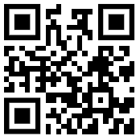
Join our festive lunch by ordering on ParentPay for
…………Tuesday 12th December…………
MAINS
Roast Turkey in Gravy, Or
Quorn Roast in Gravy
SIDES
Roast Potatoes, Mini Sausage, Stuffing, Carrots and Cabbage
DESSERT
Snowy Cupcake
Scan QR code to order, no later than Thursday 30th November !
*Special diets will remain in place.

